Slide 1
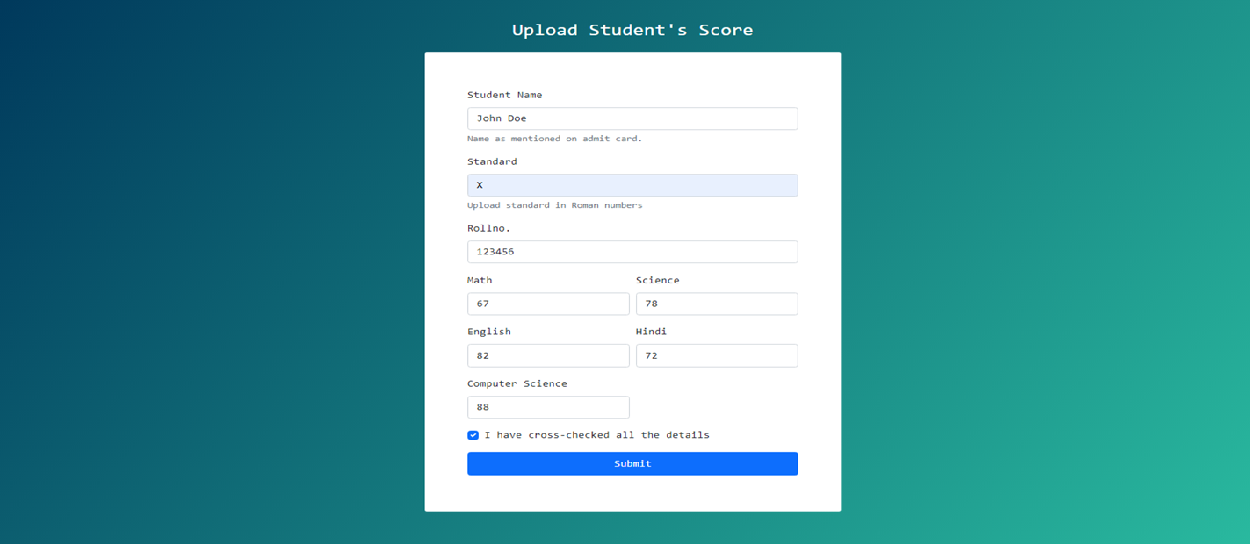
Teachers portal for uploading student’s Marks

Slide 2
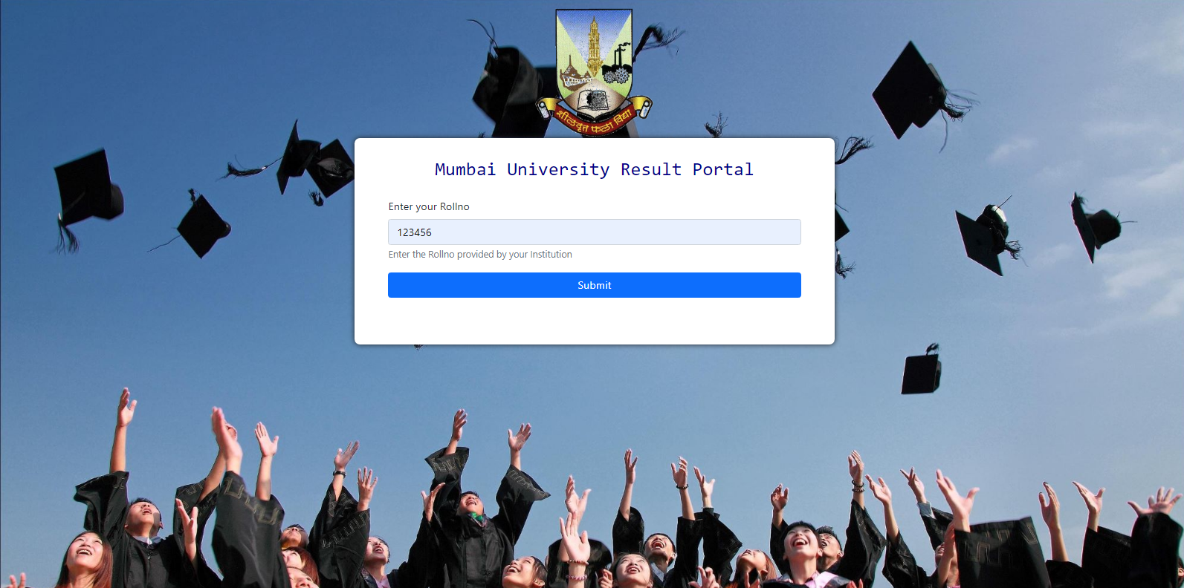
University portal where students can submit their Rollno and receive their marks

Slide 3
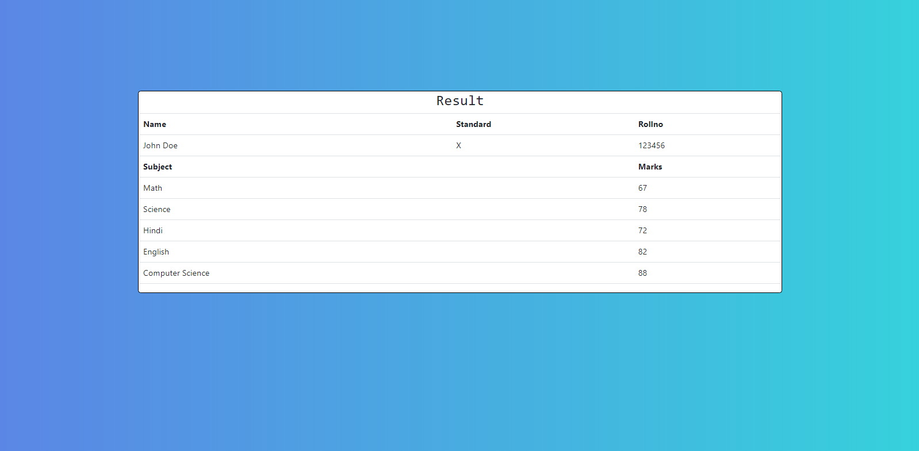
Students receiving their respective result after submitting Rollno

